Slide 1
Bacteria that duel: A study of T6SS
Jackie Corbitt
Wiggins Lab
University of Washington

Slide 2
Why do we care?
What is it?
Bacterial Type VI secretion system (T6SS)
Secretion system: in contrast to excretion, product may have function!
Recently discovered (2006) toxin delivery system
Allows bacteria to prey on surrounding target cells by injecting proteins which inhibit the target cell's natural functions
Found in 30% of Gram-negative bacteria – mechanism highly conserved in different species

Slide 3
Schematic of the T6SS System
Notes:
One t6ss in p. aeruginosa (hsi1) uses tse1, tse2, tse3 like I mentioned – but not all t6ss do that! Each have their own effector proteins, we’re pretty sure
(we don’t know how tse2 gets into cytoplasm – may or may not happen after tse1, tse3 degrade peptidoglycan layer)
Not all of this model has been proved right now! People just assume this is what happens

Slide 5
What does it do?
Used by bacteria to form biofilms
Biofilm is “any group of microorganisms in which cells stick to each other on a surface” – Wikipedia. Typically all components of the biofilm are the same species.
develop in infections (for example, chronic wound infections and in lung tissue of cystic fibrosis patients)
demonstrated by one species of bacteria outcompeting the others and becoming the primary infection
Notes:
Not necessarily used by bacteria to form biofilms
Not all t6ss systems used to form biofilms (for instance three t6ss in p. aeruginosa, not all do exactly the same thing)
For later bullet points: our HYPOTHESIS is that T6SS contributes to these infections, but we don’t KNOW that (Michelle’s lab working on it!)

Slide 6
How do we study it?
Track the movement of individual components of the T6SS using fluorescent labeling!
Investigate dynamics of proteins separately
Investigate dynamics of interactions of two proteins at once

Slide 7
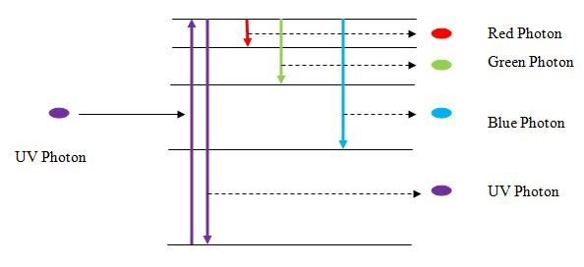
Fluorescence microscopy
Quantum levels of fluorescence.
www.antonine-education.co.uk
Conceptual diagram of fluorescence microscopy. Wikipedia.

Slide 8
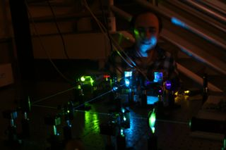
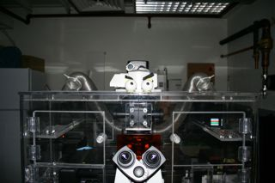
Our microscopes!

Slide 9
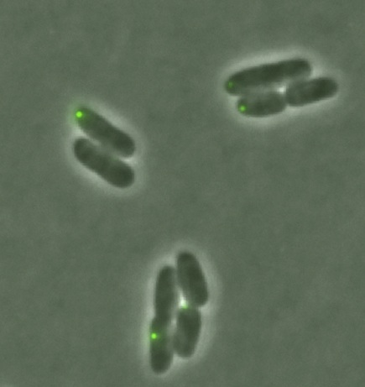
The kind of data we see (except we see more)
ittakes30.wordpress.com

Slide 10
We see this much!

Slide 11
Example data (movie)

Slide 12
Some previous work
What does T6SS action look like?
Is it somehow contact-dependent?
Will it target itself or only other types of bacteria?
If it targets itself, does that mean T6SS has some other function than poison?

Slide 13
Overview of TLFM-based intercellular interaction analyses
LeRoux M et al. PNAS 2012;109:19804-19809
Overview of TLFM-based intercellular interaction analyses.
Consecutive cropped frames from a typical TLFM experiment in which two populations of differentially labeled cells (B. thailandensis attTn7::gfp and P. aeruginosa attTn7::mCherry) were cocultured and imaged. (Scale bar, 2 μm.)
Cell masks generated by image segmentation. (Lower) Dashed outline depicts a software-identified lysis event. Hypothetical cell identification numbers are shown.
Example of cell-specific values measured during automated analysis. Certain data are recorded once and pertain to the cell lifetime as a whole (blue); other parameters vary between frames (orange).

Slide 14
Assembly and localization of the T6S apparatus is influenced by neighboring cells.
LeRoux M et al. PNAS 2012;109:19804-19809

Slide 15
Relation between foci forming?
How long do these foci last?
How long does it take them to respond to systems being formed around them?

Slide 16
Lifetime of foci over a 100 frame capture
foci are overwhelmingly only lasting one frame!
One frame is approximately 0.7 seconds (we can now do this faster, about 0.3 seconds)

Slide 17
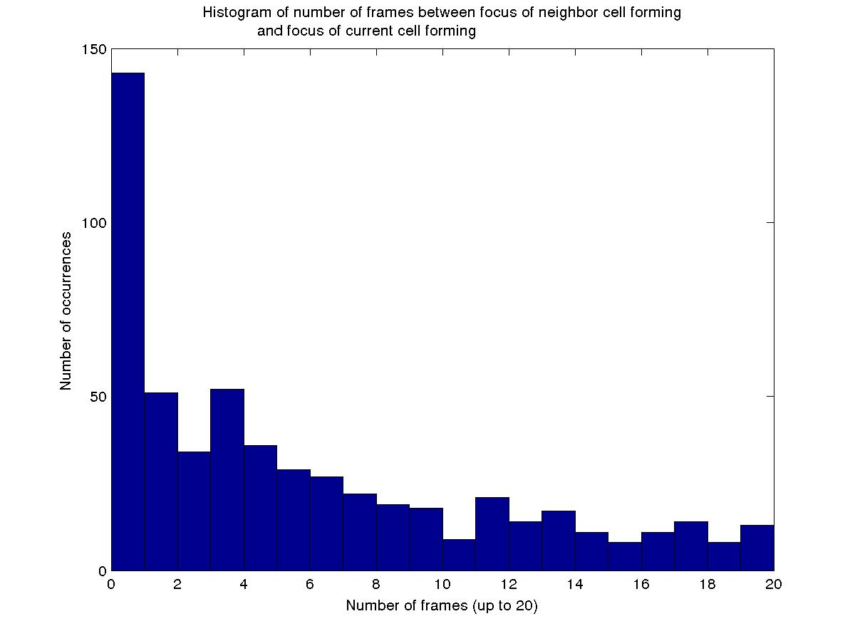
Next steps:
Use this information to determine rates/number of events in each region
Fit to Poisson distribution – random or not?

Slide 18
Conclusions (for this project): unknown!
T6SS systems are forming very rapidly!
Do they have time to function?
Are they there as a defense so neither attacks?
Are there subpopulations of systems, some of which are very dynamic and some of which are more “sedentary”?

Slide 19
Next: Do foci appear in same location or move around?
Review: foci more likely to form next to other cell, esp. other cell with focus
Once system formed, likely to reform in same location?
Mechanism options:
Components of system stay in roughly the same place, so system forms again in same location with original materials
System forms in another location:
Components of system moving about more randomly
OR components being degraded and resynthesized, so new location independent of previous location

Slide 20
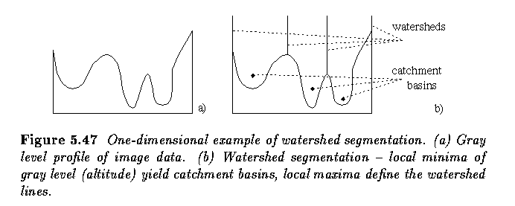
Methods: Watershed!
Easy way of determining regions
Can use this on a “summed image” to determine regions
http://www.engineering.uiowa.edu/~dip/lecture/segmentation3.html

Slide 21
General algorithm
Sum all images together
Watershed the summed image (using Matlab’s handy algorithm to do so)
In each individual image, track foci that appear in watershed regions
Write an array which stores information about foci in each watershed region for each time frame

Slide 22
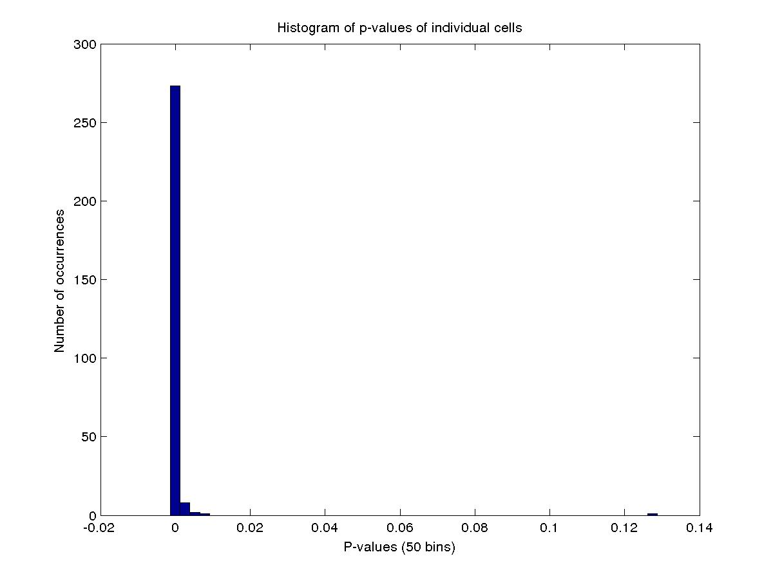

Slide 23
Two-protein colocalization!
Label different proteins with different colors
How do they interact?
Do they colocalize?
What are the time scales and dynamic rates between colocalization of different proteins?

Slide 24
Two color image

Slide 25
Next project: two types of T6SS at once!
Model organism P. aeruginosa has three types of T6SS
Do these interact?
What are the dynamic differences?
What causes the different systems to activate?

Slide 26
Acknowledgements
NSF Graduate Research Fellowship
ARCS Fellowship
Dr. Wiggins and Dr. Kuwada
Members of the lab: Julie Cass, Stella Stylianidou, Sarah Mangiameli, Scot McBride, Colin Lamont, Erik Anson
Collaborators: Dr. Mougous, Michele LeRoux (UW Microbiology)

